Slide 1



Database Project on
Tourism & Travels

Slide 2

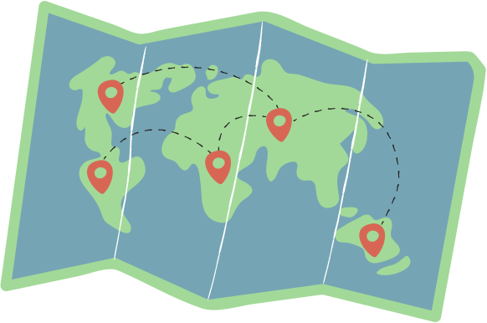
Group Members
Name | Registration ID
Md. Abidur Rahman Khan | 21201191
Azlina Arabi Hossain | 21201192
Afiah | 21201193
Mumtaheena Binte Ahmed | 21201198
Sadman Bin Khorshed Amio | 21201201

Slide 3
Table of Contents
No. | Contents
1 | Project Description
2 | Project Features
3 | Sets and Attributes
4 | E-R Model
5 | Schema Diagram
6 | Sample Queries

Slide 4

Description
It is a digital platform offering centralized information on different destinations, accommodations, attractions, and services. It enables efficient trip planning, online bookings, and user reviews, enhancing the travel experience for tourists while supporting businesses with valuable insights and marketing opportunities.

Slide 5


Features
Manage the Available Packages (Admin)
Manage the Hotel Information available under packages (Admin)
Manage the Attraction available under packages (Admin)
Manage the transports available under packages (Admin)
Enter User Info (User)
Book a certain package (User)
Coordinate the hotels, transports and attractions combination (Admin)
Coordinate the combinations with different packages (Admin)

Slide 6


Attributes
Entity Set
Attraction
Hotel
Transportation
Package
Review
User
Relational Set
bookings
package_hotel_service
package_attraction
pack_trans
user_hotel

Slide 7

Entity Set
Attraction
attraction_ID
name
description
Ticket Price
Category(e.g., Historical, Natural, Entertainment)
Hotels
hotel_ID
name
description
address
contact Number
Transportation
Transportation_ID Type (e.g., Flight, Bus, Train)
Departure Location
Arrival Location
Fare
Route

Slide 8
Entity Set
Reviews
Review_ID
package_name(FK)
package_type(FK)
User_ID (F-Key)
Comment
User
User_ID
Name
E-mail address
NID_number
Phone Number
Packages
Package_name
package_type
Description
Price
Hotel_ID (F-Key)
Location_ID (F-Key)
Attraction_ID (F-Key)
Number of Travelers
Reviews (F-key)

Slide 9
Relational Set
Bookings
User_ID
Package_name
Package_type
payment
package_attraction
Package_name
Package_type
attraction_id
package_transport
Package_name
Package_type
transportation_id
User_hotel:
user_ID (FK)
hotel_ID (FK)
package_hotel
Package_name
Package_type
attraction_id

Slide 10
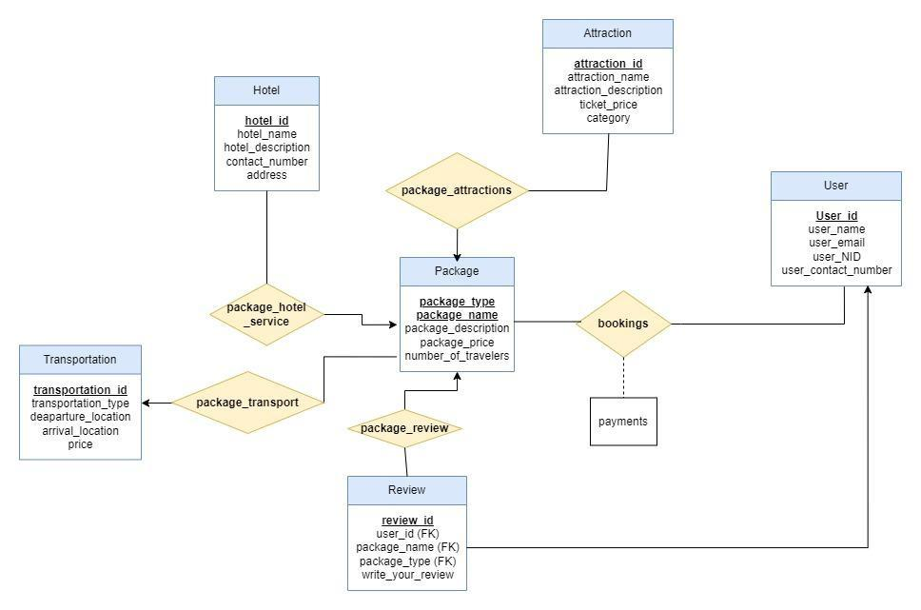
Design of the project (E-R Model)

Slide 11
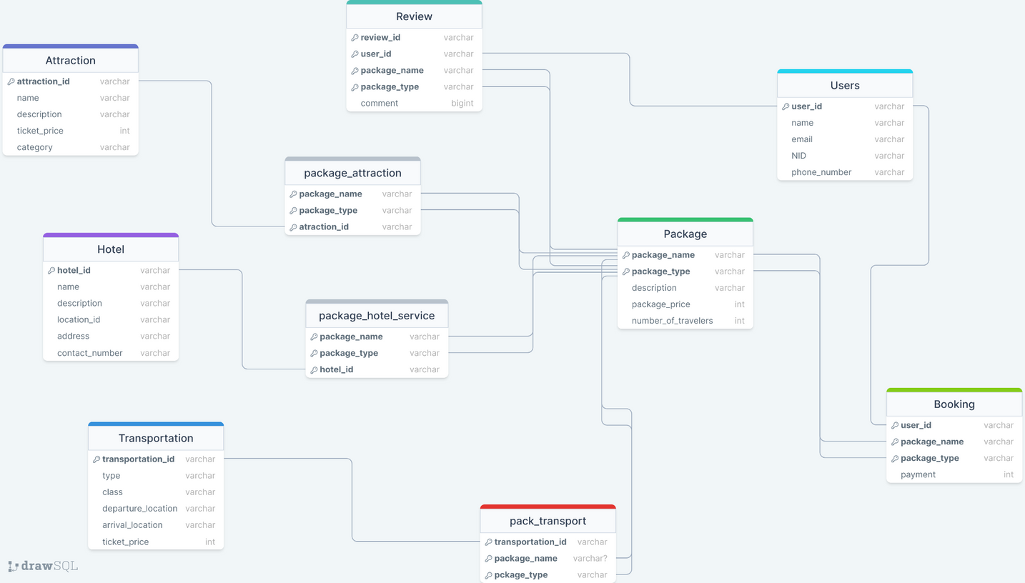
Project Design (Schema Diagram)

Slide 12
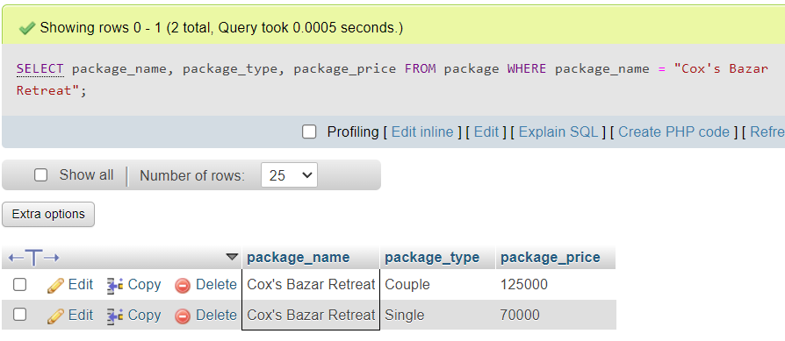
Sample Query
1.What are the prices of all the packages for “Cox’s Bazar Retreat”?

Slide 13
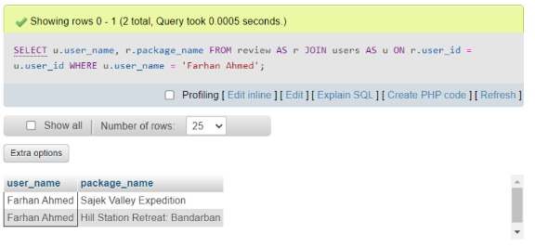
Sample Query
2.Where did Farhan Ahmed go on tour?

Slide 14
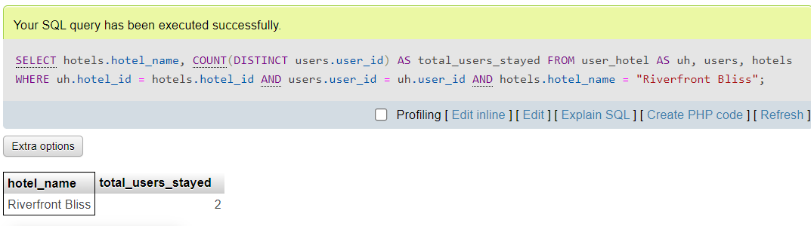
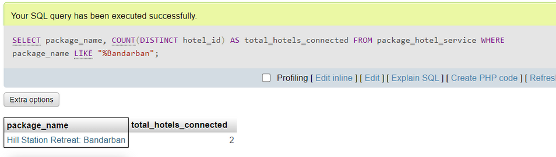
Sample Query
3. How many users stayed in “Riverfront Bliss”?
4. How many hotels are connected to Bandarban’s package?

Slide 15
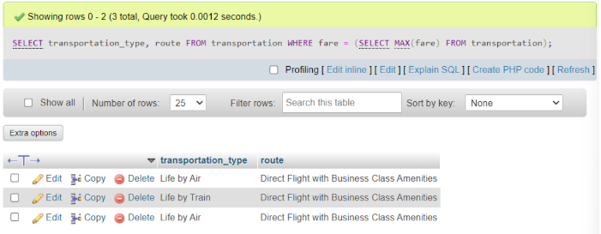
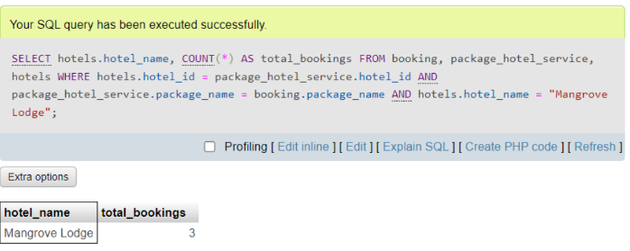
Sample Query
5. What is the route of the most expensive transport?
6. How many bookings were made in packages that are connected to hotel “Mangrove Lodge”?

Slide 16
Thank You!!
The world is beautiful! Let’s travel!!

